Slide 1
EventSourcing and CQRS
A Dynamic DUO that will solve global warming
(Or maybe something a bit more realistic)
Prairie Dev Con 2022

Slide 2
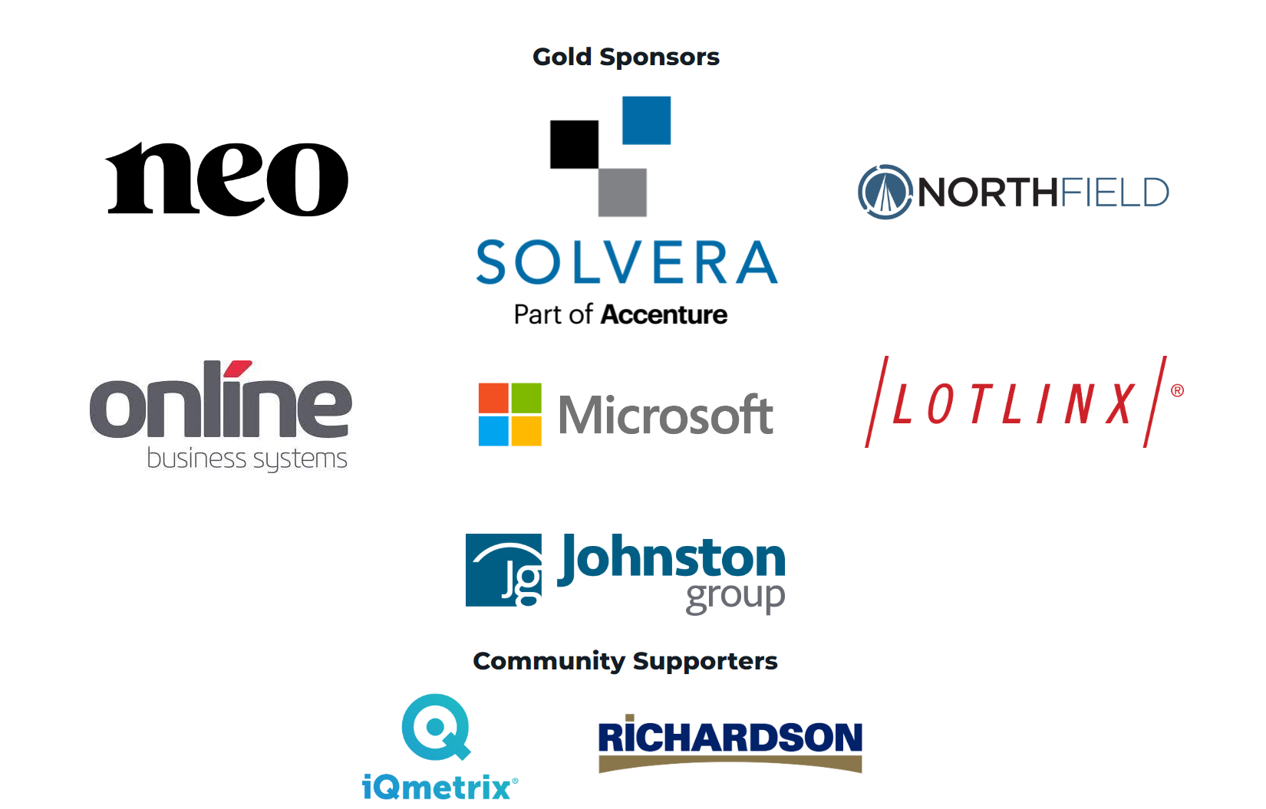
Prairie Dev Con 2022 Winnipeg

Slide 3
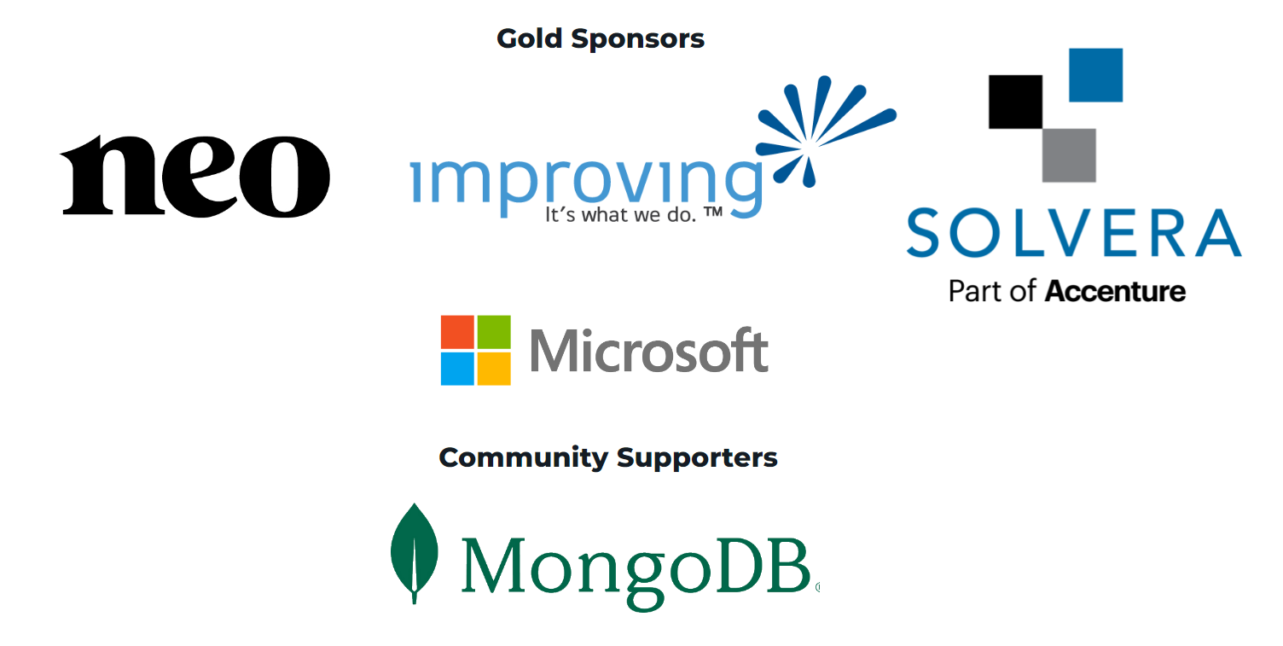
Prairie Dev Con 2022 Calgary

Slide 4





Introductions
Dave White AKT, AKC, PSM, CSM, MVP Alumni
Principal Consultant – Depth Consulting
In technology for over 20 years
Cloud-native, DevOps, Architect, Developer
Kanban/Agile Evangelist, Speaker
WesternDevs member
Alumni MS MVP (2014, 2015, 2016)
http://linkd.in/giMxuw
@AgileRamblings
https://www.westerndevs.com
dave@depthconsulting.ca
https://github.com/agileramblings

Slide 5
Agenda
Why are we here?
EventSourcing
CQRS
Putting it all together
Final Thoughts

Slide 6
Why are we here?
The APPLICATION story we’ve all (probably) heard before

Slide 7
Learn. Share. Laugh. Cry.

Slide 8
There once was an application…
Started in about 2012
ASP.NET MVC – .cshtml with some JSON over HTTP RPC added
Single database
Entity Framework
100 users or so
No meaningful customer integrations
Minimal reporting

Slide 9
7-8 years later…
Still ASP.NET MVC – .cshtml with a lot more JSON over HTTP RPC added along the way
Many Telerik/KendoUI grids/components
Single database
Entity Framework still
3000 users that include people, devices and load from third-party vendor integrations
> $300 million dollars in annual revenue flow through this application
BI ETLs run at night
Large B2B EDI transactions run twice daily from major (read: $$$) customers

Slide 10
Sounds ok until…
Users complain about application slowness all the time.
Some grids for LOB activities take minutes to load
Analysis suggests the database is the reason…
Let’s scale up the database hardware!
Let’s allow queries and other transactions to use uncommitted, in-progress transactional writes
Let’s spin up a read-only replica to try to take some of the load
Call in the consultants to optimize data access
SET TRANSACTION ISOLATION LEVEL READ UNCOMMITTED;

Slide 11
It didn’t work…
Users continue to complain about application slowness all the time.
LOB activities still take minutes to load
Long-running nightly activities don’t finish by morning business hours
Analysis suggests the database is still the problem…
The databases cost between $4k-6k per month in Azure
Always pressing up against the biggest memory SKU VMs available in Azure
Allowing transactions to interact creates data integrity problems
No auditing. With 3000 users/agents and data integrity problems, this becomes a requirement. This may add some load to the database.
Read-only replica isn’t having the expected impact
There is nothing the consultants can do with the current architecture and EF

Slide 12
The problem wasn’t SQL Server.

Slide 13
We had to do something…
Begin cleaving chunks out of the monolith
Don’t build another monolith
Don’t use the current monoliths database either
Within a microservice, re-evaluate how to do data access
Ensure flexibility with regard to distributing workloads
Auditability is a requirement
This isn’t a talk about microservices
Diverse consumers of business data need to be supported
REACT applications
ETL workloads
B2B service integrations
Modern consumers have modern performance expectations

Slide 14
EventSourcing
Demystifying and making it LESS scary

Slide 15
Choosing EventSourcing as a persistence mechanism will have a profound impact on the overall implementation of your application.

Slide 16
EventSourcing
… is a different style for saving System of Record business data
… aligns with alternate object modelling techniques (DDD)
… provides an intuitive approach to modelling important business objects in code
… is a bit more work
… may support auditing requirements by default
… won’t bite you

Slide 17
Technically speaking…
Stream of events describing what happened to an object
The stream is (should be) append-only. Events are immutable.
Each event represents a new “version” of the object
Events happen at a point in time
Re-hydrating the object means reading the stream and applying events one at a time in order

Slide 18
A Visual
Customer
v0
CustomerCreated
v1
BasicInfoUpdated
v2
AddressAdded
v3
PhoneAdded
v4
BasicInfoUpdated
v5
AddressMadePrimaryShipping

Slide 19
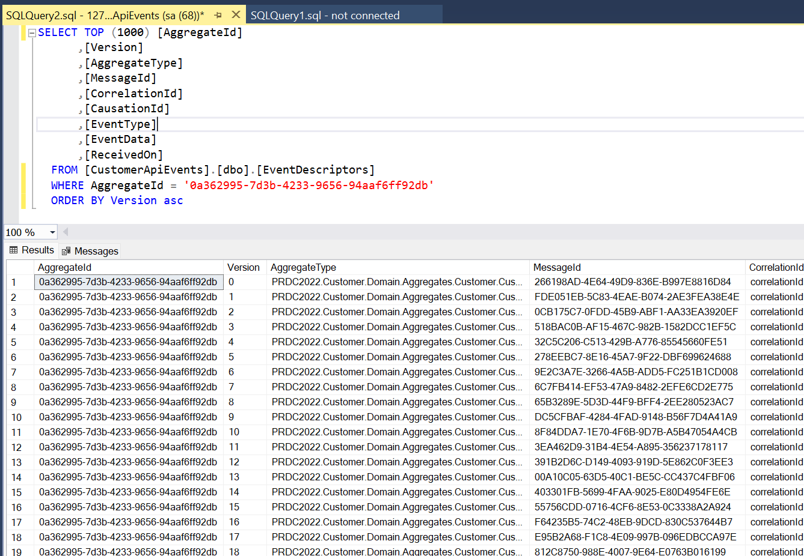
Event Store Records

Slide 20
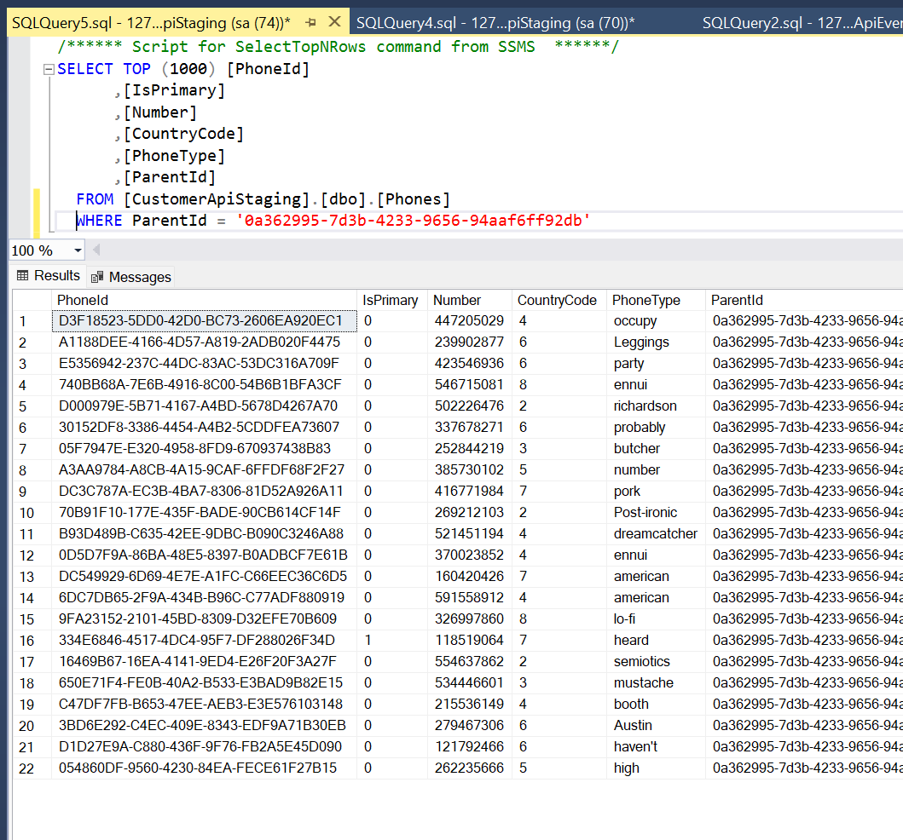
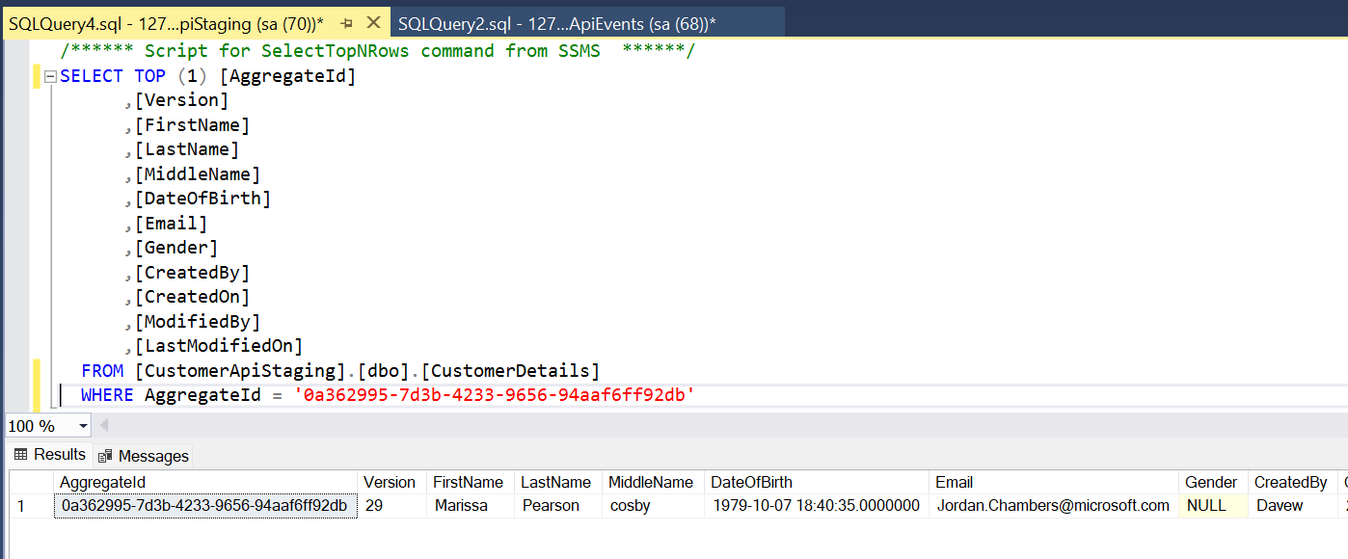
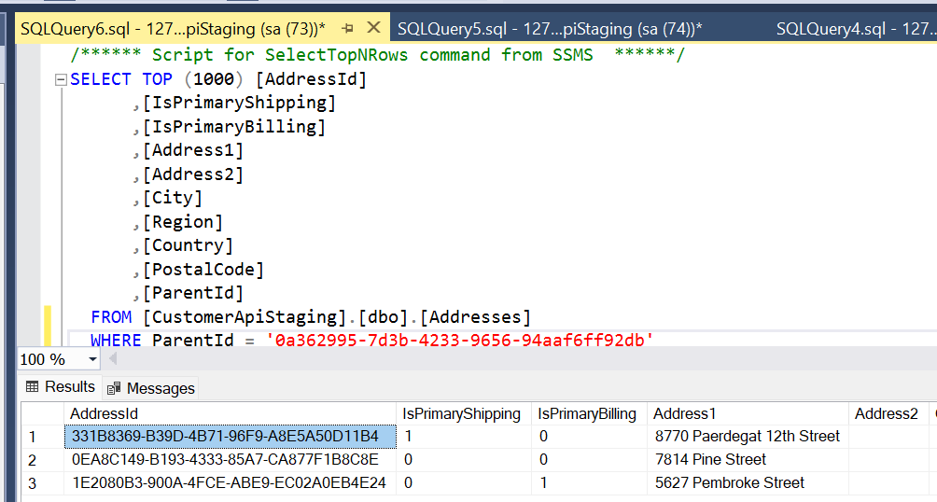
vs Relational Records

Slide 21
One Schema to Rule them All
Adding data to an event stream is as simple as adding events types, stored in the stream
Adding data to a relational model usually means new tables or discriminators (yuck!) to an ever widening table

Slide 22
A brief word about consistency…
Immediately consistent (state) vs. eventually consistent
Objects in memory are the only place where we can be certain of being immediately consistent
Everything else should be considered eventually consistent
Anywhere that data is at rest is eventually consistent
First one to save wins!
This is why versioning of domain objects is valuable

Slide 23
(Domain) Event handling too!
With event-sourced persistence, your application can respond to specific events when persisting new items to the stream
Handlers are decoupled from workflows in code
Register event handlers and they are invoked by an in-process message bus
Projectors and Reactors are two broad categories of event handlers
Projectors emit projections (point in time picture of a business object)
Reactors initiate an out-of-process interaction (Post to API, place a message on a external message bus)

Slide 24
Pros/Cons
PROS
ConS
Intuitive object modeling
What to test (scenarios) are easier to think about
Easy (read: none) schema management
Built-in auditing/history retention
Version control of business objects
Supports more successful cloud-scale (distributed) workloads
Write-heavy workloads required extra care
More data (de-normalized) usually means more storage costs
Acquisition costs (queries) from event stream are may be more expensive
Mitigated with snapshots/mementos
Cannot easily query data directly anymore
Objects need to support old events
More complexity
Different/novel

Slide 25
CQRS
Spreading the load over space and Time. And… 42.

Slide 26
CQRS is not an architecture. It is a mindset.

Slide 27
CQRS
… Command Query Responsibility Segregation
… does not have to go hand in hand with EventSourcing
But they are a powerful combination
Always there are two…
… provides an intuitive approach that guides fit-for-purpose persistence implementations to emerge
… is a bit more work
… won’t bite you

Slide 28
Commands
Commands are a request to change the state of the world
This usually means some sort of “write” activity
e.g.
Please create a Customer record
Please add a phone number to a customer record

Slide 29
Query
Queries are a request to see the state of the world
This should not have any side-effects that change the state of the world
These side-effects are commands in disguise
Queries (and responses) can (should?) be designed for specific consumers
JSON consumers
ETL integrations
Reporting tools
e.g.
Get a customer record
Get a summary record of customer address/phone usage

Slide 30
Why should we keep these segregated?
Ratio of workloads informs architectural design choices
Write workloads can be optimized/tuned
Query workloads can be optimized/tuned
May be deployed separately
Can mitigate the “single persistence mechanism instance” risk
Encourages fit-for-purpose query stores
NoSQL/Document databases
TimeSeries databases
Relational databases that are not attached the event store
Graph databases

Slide 31
Pros/Cons
PROS
ConS
Encourages fit-for-purpose persistence mechanisms
Separating command specific loads from query load allows provisioning “the right amount” of persistence compute
Encourages architecturally consistent decisions
Write-heavy workloads required extra care
Query-heavy workloads can really benefit
More data (de-normalized) usually means more storage costs
More complexity
Different/novel

Slide 32
Putting it all together
Did it work the way we expected?

Slide 33
I have code!!!

Slide 34
Final Thoughts
Some of mine, some of yours

Slide 35
My thoughts
I am a proponent of EventSourcing and CQRS and I am hoping that you will be too … someday.
Someday will come if you aren’t intimidated by either of these techniques, which I am hoping you’ve taken away from today.
It isn’t an all or nothing adoption
Neither ES or CQRS will bite you
any more than any other code you may write
Any novel technology comes with sharp edges
Practice. Be Safe. Learn. Collaborate.

Slide 36
Questions
If ES or CQRS is still scary, why?
Technical questions?
Usage concerns?
Adoption concerns?

Slide 37
Resources
https://github.com/agileramblings
PRDC2022 – arriving soon
Battleship-CQRS
Eric Evans – Domain Driven Design – Amazon.ca
Vernon Vaughn – Implementing Domain Driven Design – Amazon.ca
Greg Young
https://cqrs.files.wordpress.com/2010/11/cqrs_documents.pdf
https://www.youtube.com/watch?v=JHGkaShoyNs
https://www.eventstore.com/blog/author/greg-young

Slide 38
Thank you

